Slide 1
CHAPTER 6
Risk Aversion and Capital Allocation to Risky Assets

Slide 2
Allocation to Risky Assets
Investors will avoid risk unless there is a reward.
The utility model gives the optimal allocation between a risky portfolio and a risk-free asset.

Slide 3
Risk and Risk Aversion
Speculation
Taking considerable risk for a commensurate gain
Parties have heterogeneous expectations

Slide 4
Risk and Risk Aversion
Gamble
Bet or wager on an uncertain outcome for enjoyment
Parties assign the same probabilities to the possible outcomes

Slide 5
Risk Aversion and Utility Values
Investors are willing to consider:
risk-free assets
speculative positions with positive risk premiums
Portfolio attractiveness increases with expected return and decreases with risk.
What happens when return increases with risk? Ex: CAPM

Slide 6
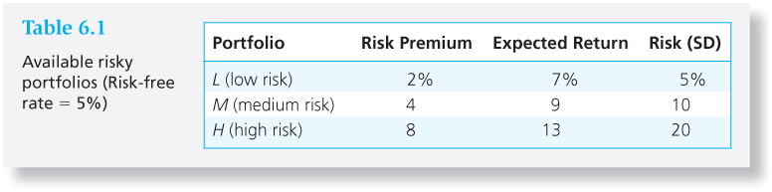
Table 6.1 Available Risky Portfolios (Risk-free Rate = 5%)
Each portfolio receives a utility score to assess the investor’s risk/return trade off

Slide 7

Utility Function
U = utility
E ( r ) = expected return on the asset or portfolio
A = coefficient of risk aversion
σ² = variance of returns
½ = a scaling factor

Slide 8
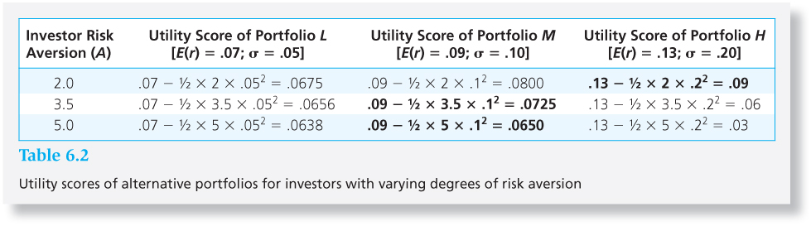
Table 6.2 Utility Scores of Alternative Portfolios for Investors with Varying Degree of Risk Aversion

Slide 9
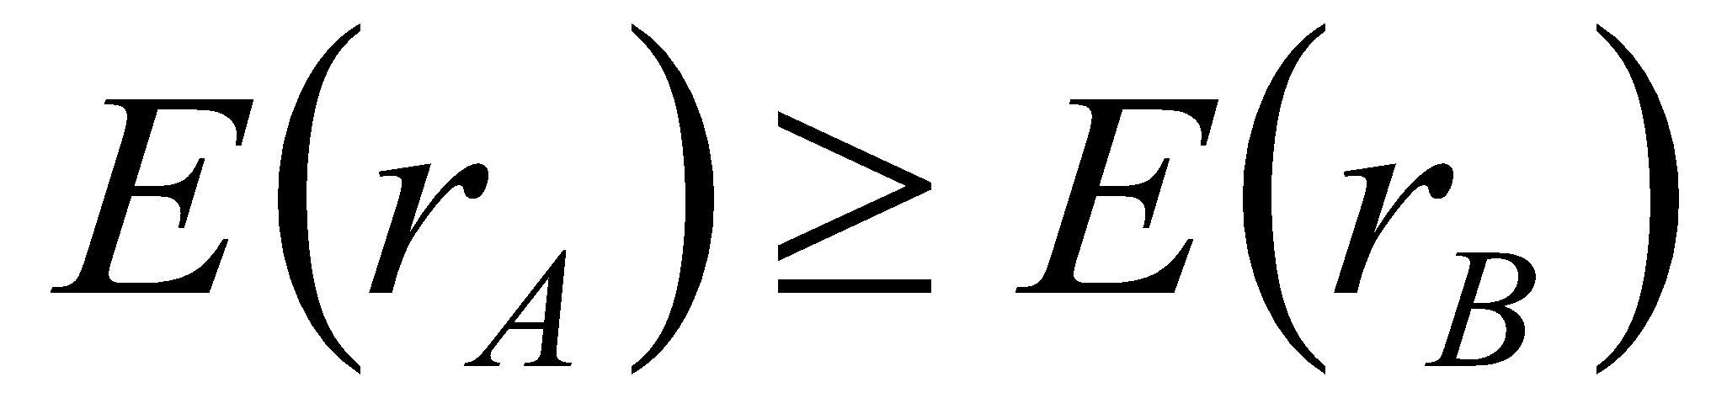
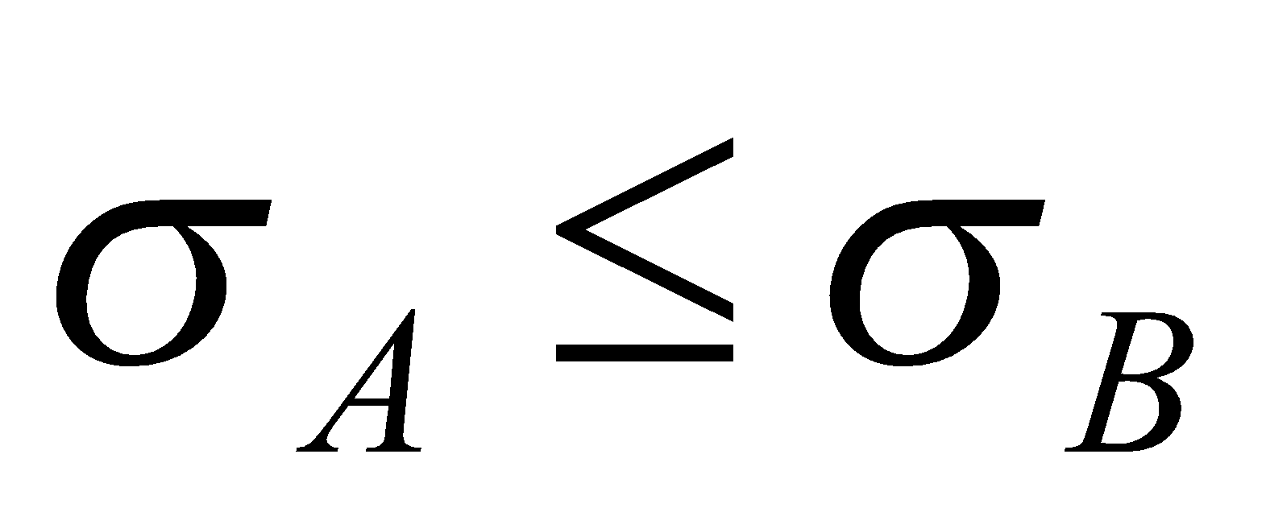
Mean-Variance (M-V) Criterion
Portfolio A dominates portfolio B if:
And

Slide 10
Estimating Risk Aversion
Use questionnaires
Observe individuals’ decisions when confronted with risk
Observe how much people are willing to pay to avoid risk

Slide 11
Capital Allocation Across Risky and Risk-Free Portfolios
Asset Allocation:
Controlling Risk:
Is a very important part of portfolio construction.
Refers to the choice among broad asset classes.
Simplest way: Manipulate the fraction of the portfolio invested in risk-free assets versus the portion invested in the risky assets

Slide 12
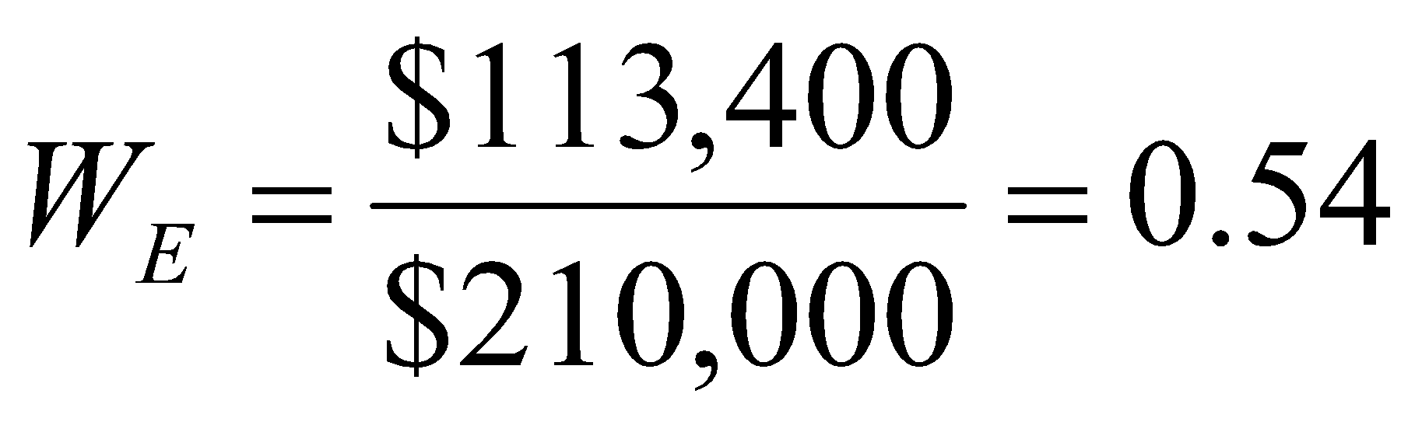
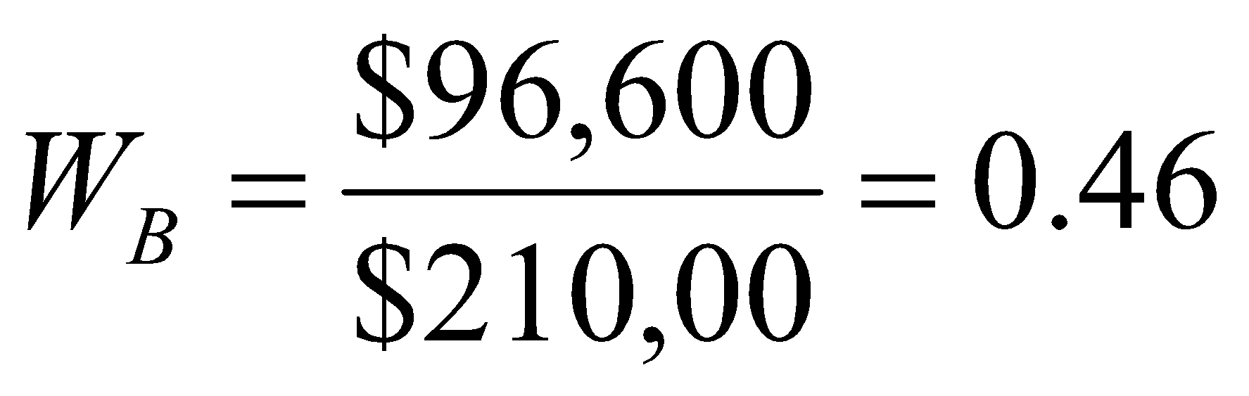
Basic Asset Allocation
Total Market Value | $300,000
Risk-free money market fund | $90,000
Equities | $113,400
Bonds (long-term) | $96,600
Total risk assets | $210,000

Slide 13
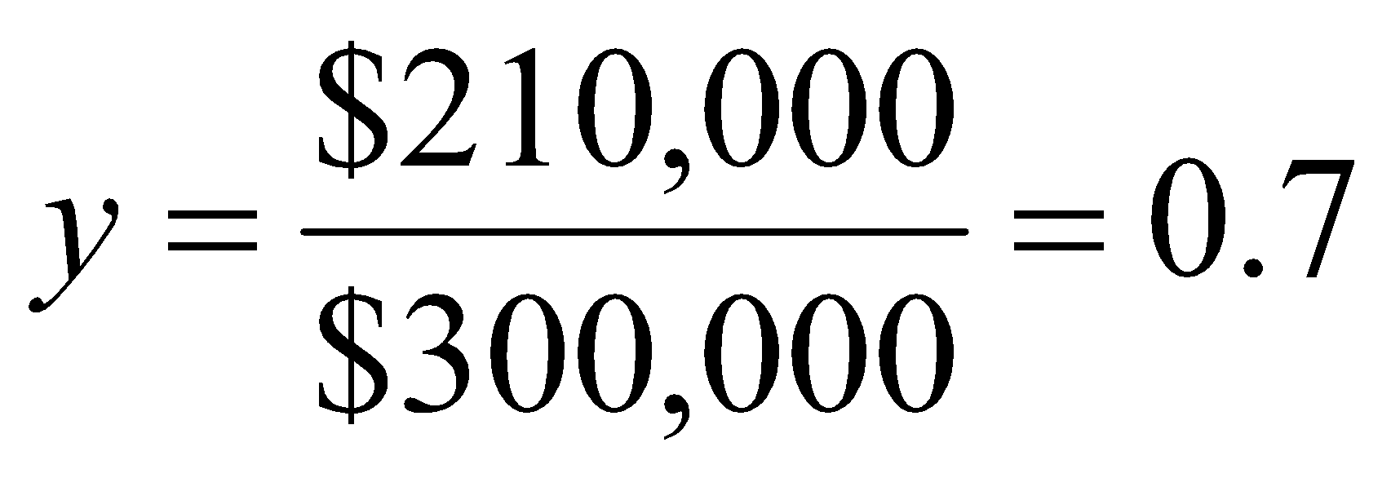
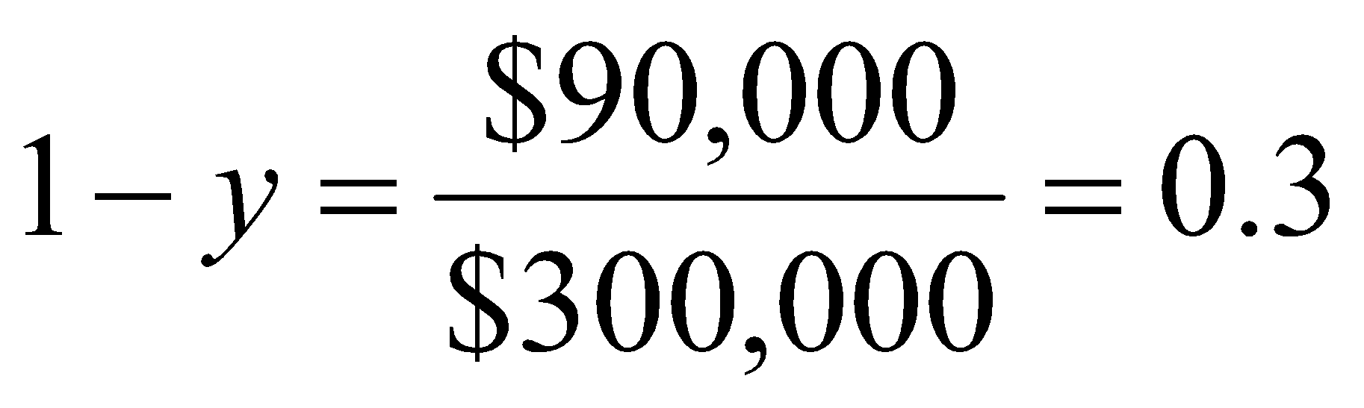
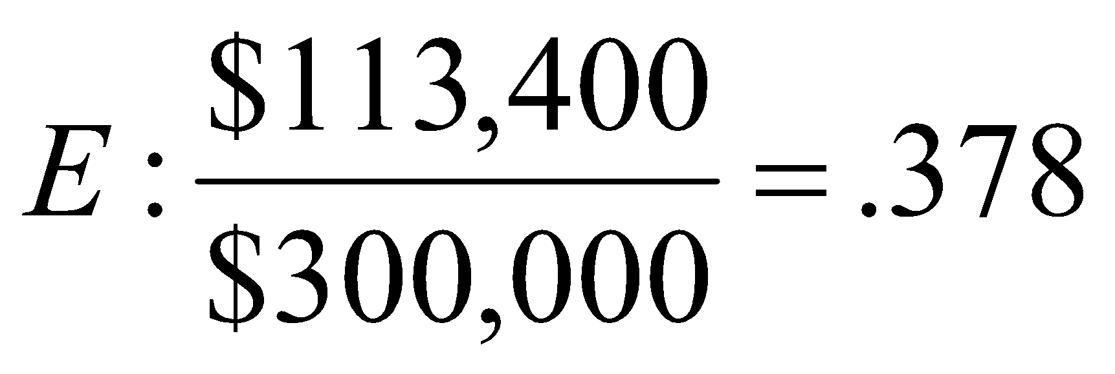
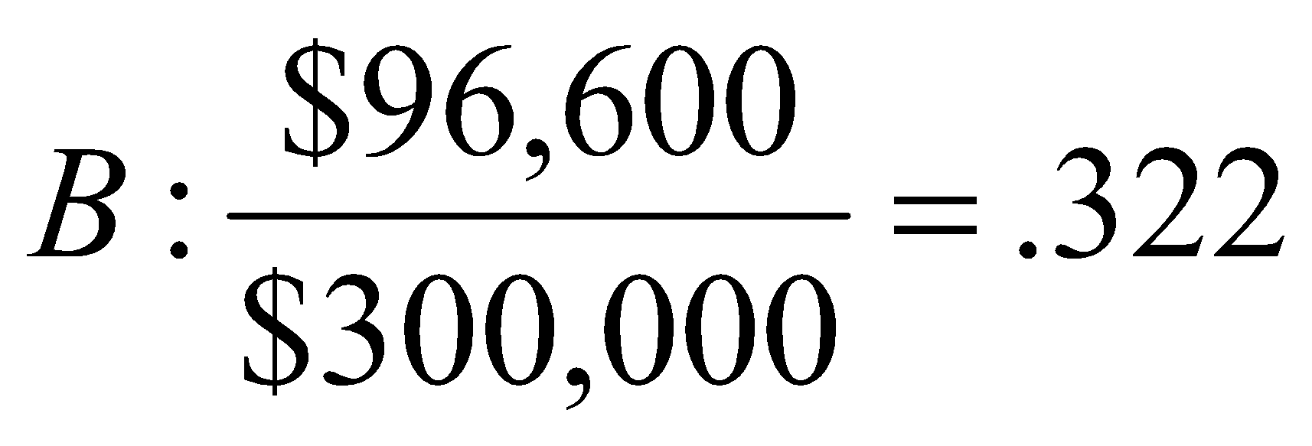
Basic Asset Allocation
Let y = weight of the risky portfolio, P, in the complete portfolio; (1-y) = weight of risk-free assets:

Slide 14
The Risk-Free Asset
Only the government can issue default-free bonds.
Risk-free in real terms only if price indexed and maturity equal to investor’s holding period.
T-bills viewed as “the” risk-free asset
Money market funds also considered risk-free in practice

Slide 15
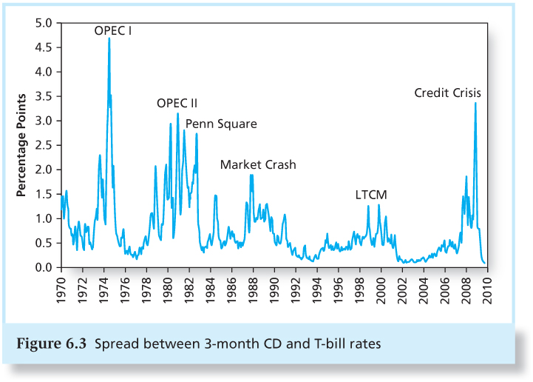
Figure 6.3 Spread Between 3-Month CD and T-bill Rates

Slide 16
Portfolios of One Risky Asset and a Risk-Free Asset
It’s possible to create a complete portfolio by splitting investment funds between safe and risky assets.
Let y=portion allocated to the risky portfolio, P
(1-y)=portion to be invested in risk-free asset, F.

Slide 17
Example Using Chapter 6.4 Numbers
r_{f} = 7%
σ_{rf} = 0%
E(r_{p}) = 15%
σ_{p} = 22%
y = % in p
(1-y) = % in r_{f}

Slide 18

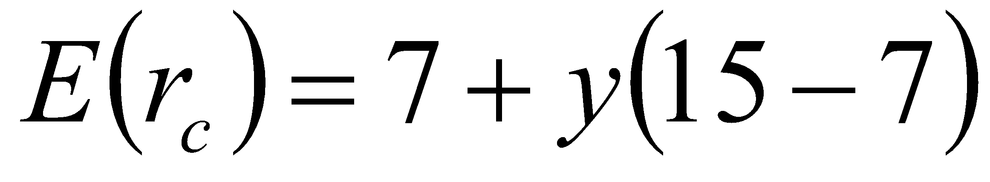
Example (Ctd.)
The expected return on the complete portfolio is the risk-free rate plus the weight of P times the risk premium of P

Slide 19
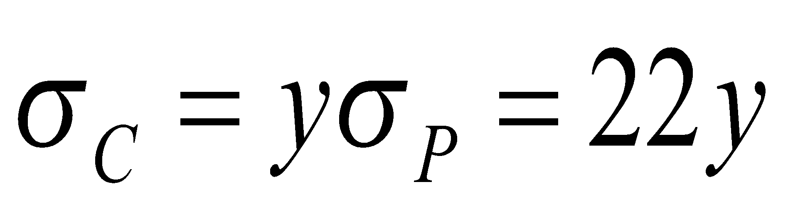
Example (Ctd.)
The risk of the complete portfolio is the weight of P times the risk of P:

Slide 20
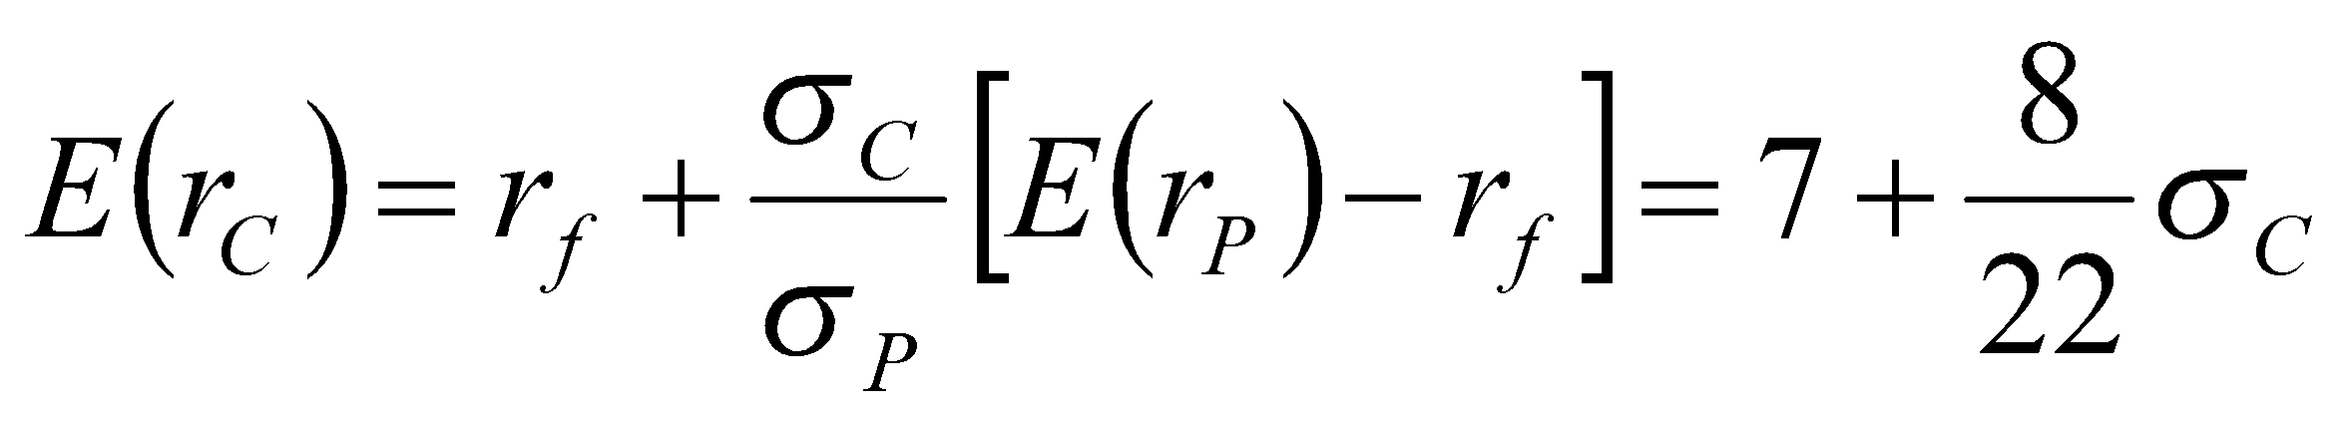
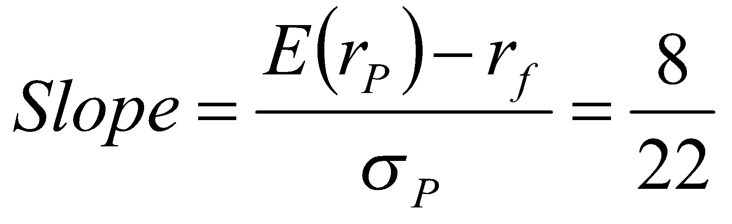
Example (Ctd.)
Rearrange and substitute y=σ_{C}/σ_{P}:

Slide 21
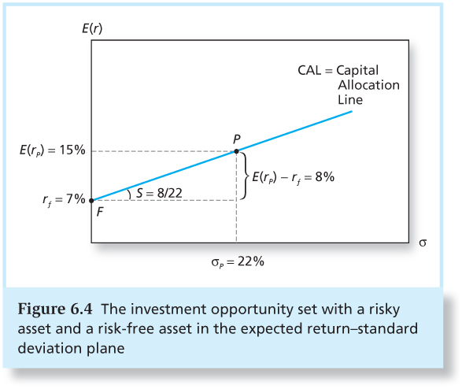
Figure 6.4 The Investment Opportunity Set

Slide 22
Capital Allocation Line with Leverage
Lend at r_{f}=7% and borrow at r_{f}=9%
Lending range slope = 8/22 = 0.36
Borrowing range slope = 6/22 = 0.27
CAL kinks at P

Slide 23
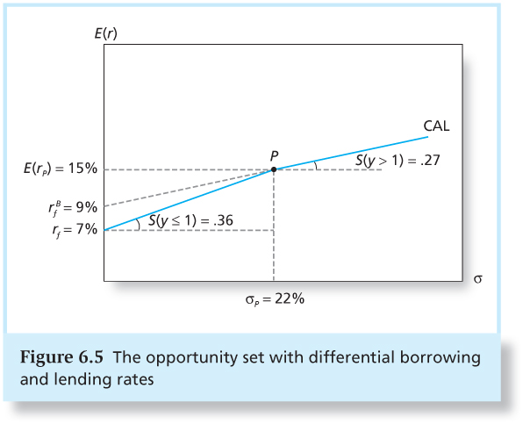
Figure 6.5 The Opportunity Set with Differential Borrowing and Lending Rates

Slide 24


Risk Tolerance and Asset Allocation
The investor must choose one optimal portfolio, C, from the set of feasible choices
Expected return of the complete portfolio:
Variance:

Slide 25
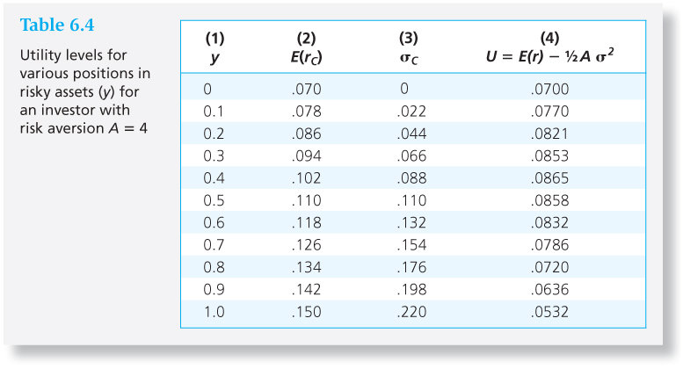
Table 6.4 Utility Levels for Various Positions in Risky Assets (y) for an Investor with Risk Aversion A = 4

Slide 26
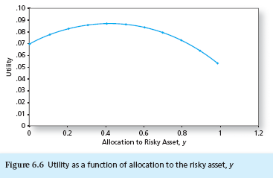
Figure 6.6 Utility as a Function of Allocation to the Risky Asset, y

Slide 27
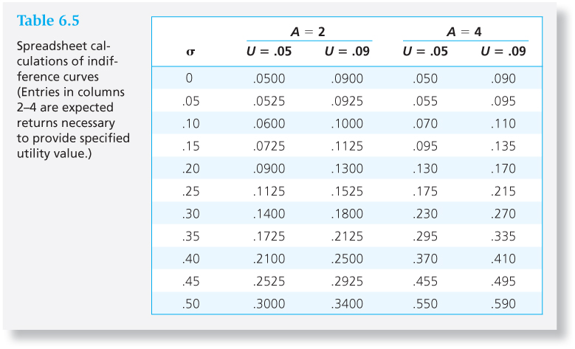
Table 6.5 Spreadsheet Calculations of Indifference Curves

Slide 28
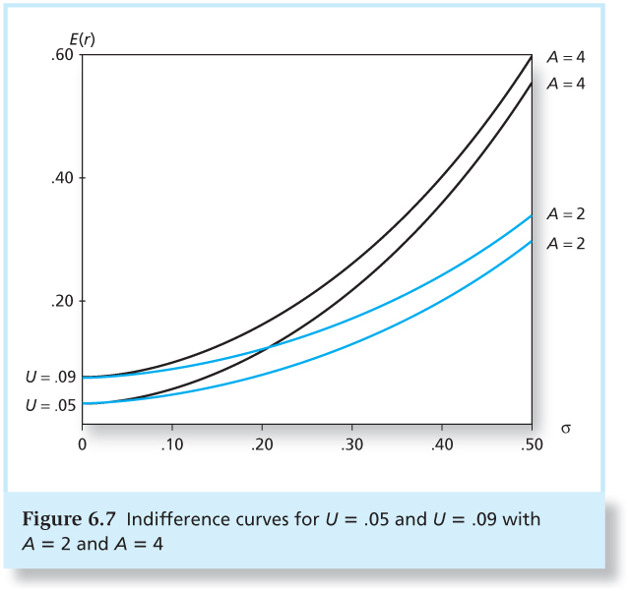
Figure 6.7 Indifference Curves for U = .05 and U = .09 with A = 2 and A = 4

Slide 29
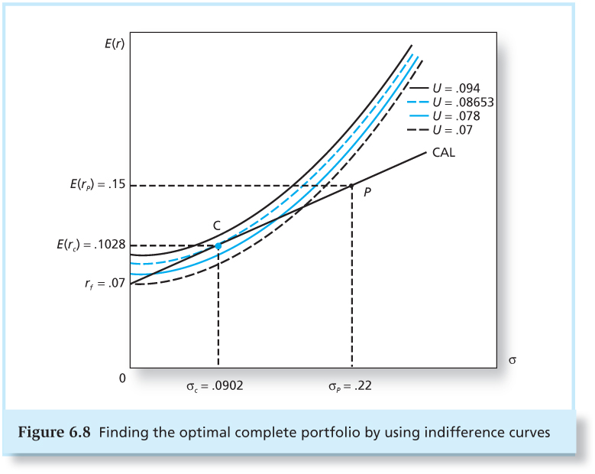
Figure 6.8 Finding the Optimal Complete Portfolio Using Indifference Curves

Slide 30
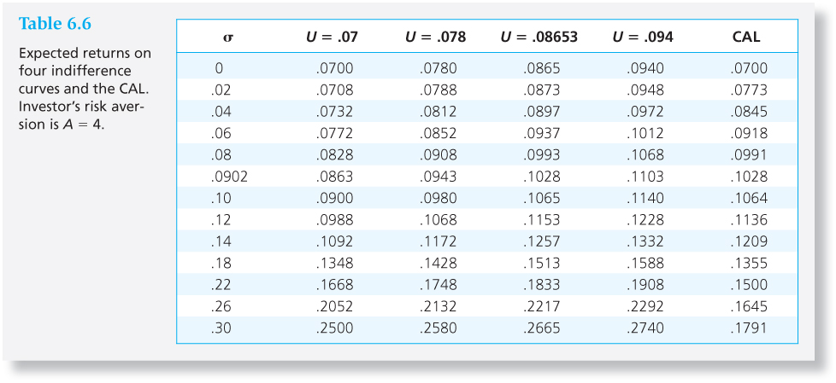
Table 6.6 Expected Returns on Four Indifference Curves and the CAL

Slide 31
Passive Strategies: The Capital Market Line
The passive strategy avoids any direct or indirect security analysis
Supply and demand forces may make such a strategy a reasonable choice for many investors

Slide 32
Passive Strategies: The Capital Market Line
A natural candidate for a passively held risky asset would be a well-diversified portfolio of common stocks such as the S&P 500.
The capital market line (CML) is the capital allocation line formed from 1-month T-bills and a broad index of common stocks (e.g. the S&P 500).

Slide 33
Passive Strategies: The Capital Market Line
The CML is given by a strategy that involves investment in two passive portfolios:
virtually risk-free short-term T-bills (or a money market fund)
a fund of common stocks that mimics a broad market index.

Slide 34
Passive Strategies: The Capital Market Line
From 1926 to 2009, the passive risky portfolio offered an average risk premium of 7.9% with a standard deviation of 20.8%, resulting in a reward-to-volatility ratio of .38.

